Slide 1
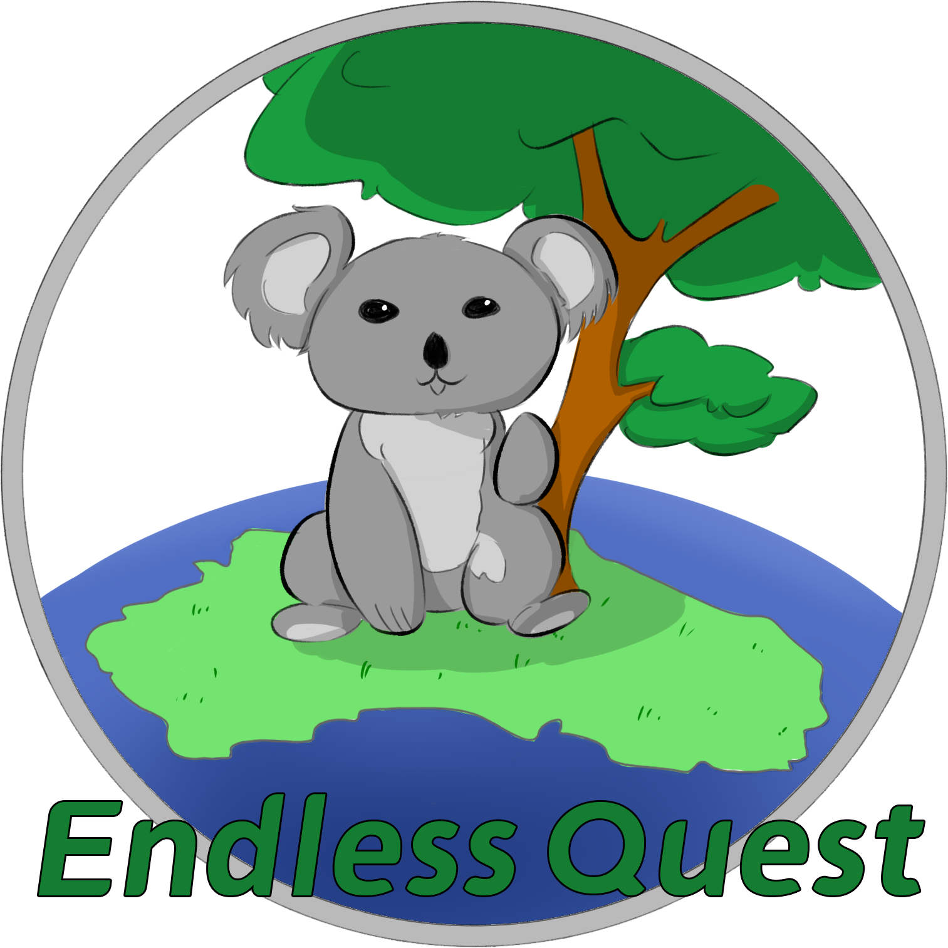
Finding your Nature Neighbors

Slide 2
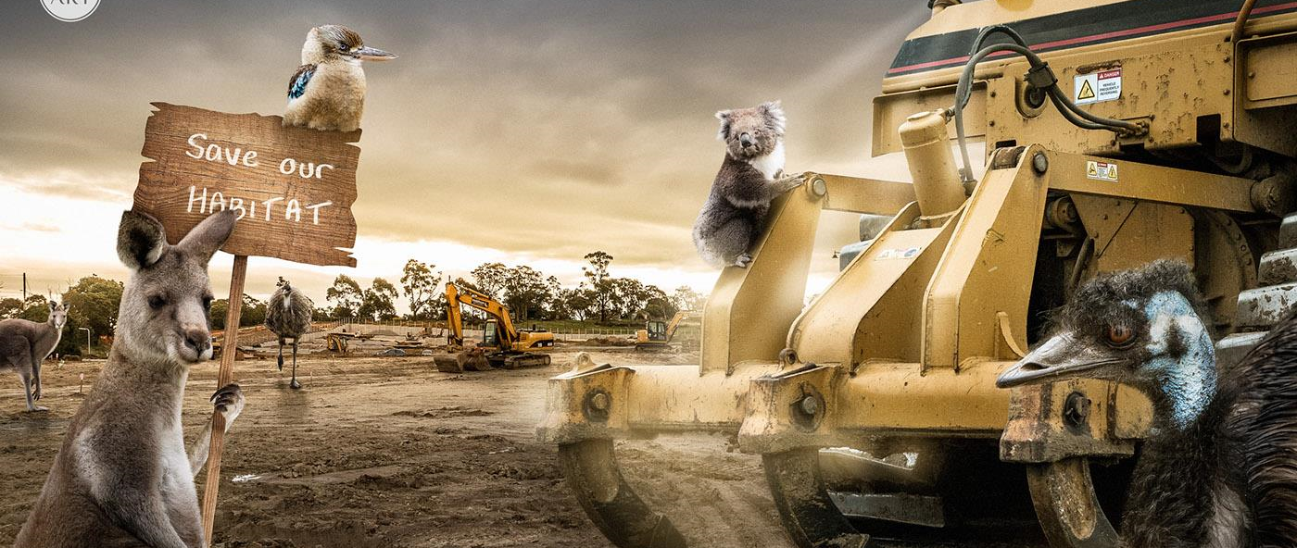
Nowaday, many species have lost their habitats due to the neglect of ecological protection.

Slide 3


Therefore, how to awaken people to protect animals has become one of the essential issues of this era.
The youth are the main group of the future of society, but most young people may not know much specific information about endangered plants and animals.

Slide 4
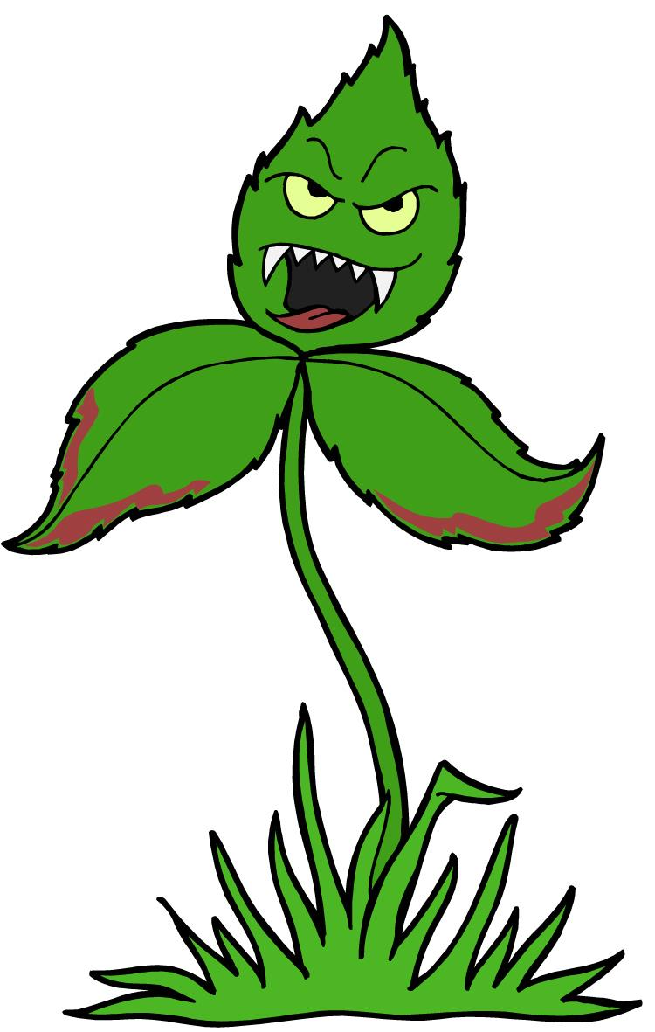
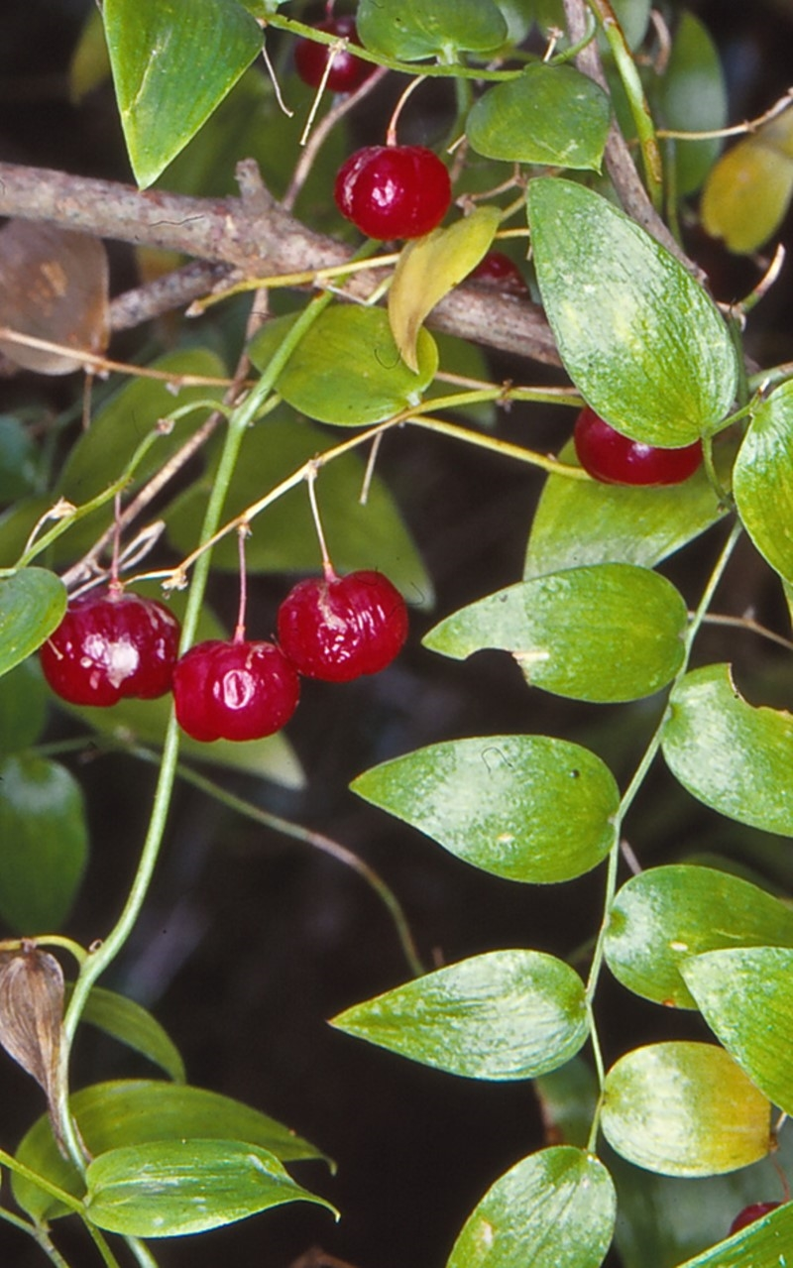
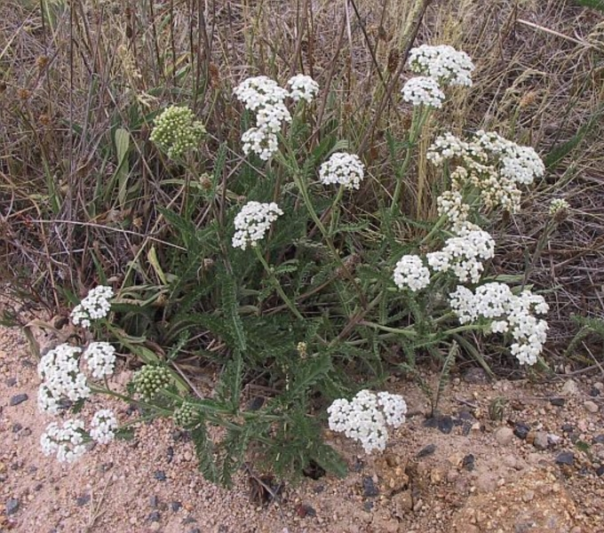
For example, some plants and animals may be harmful to the environment.
Erica lusitanica
Asparagus asparagoides

Slide 5
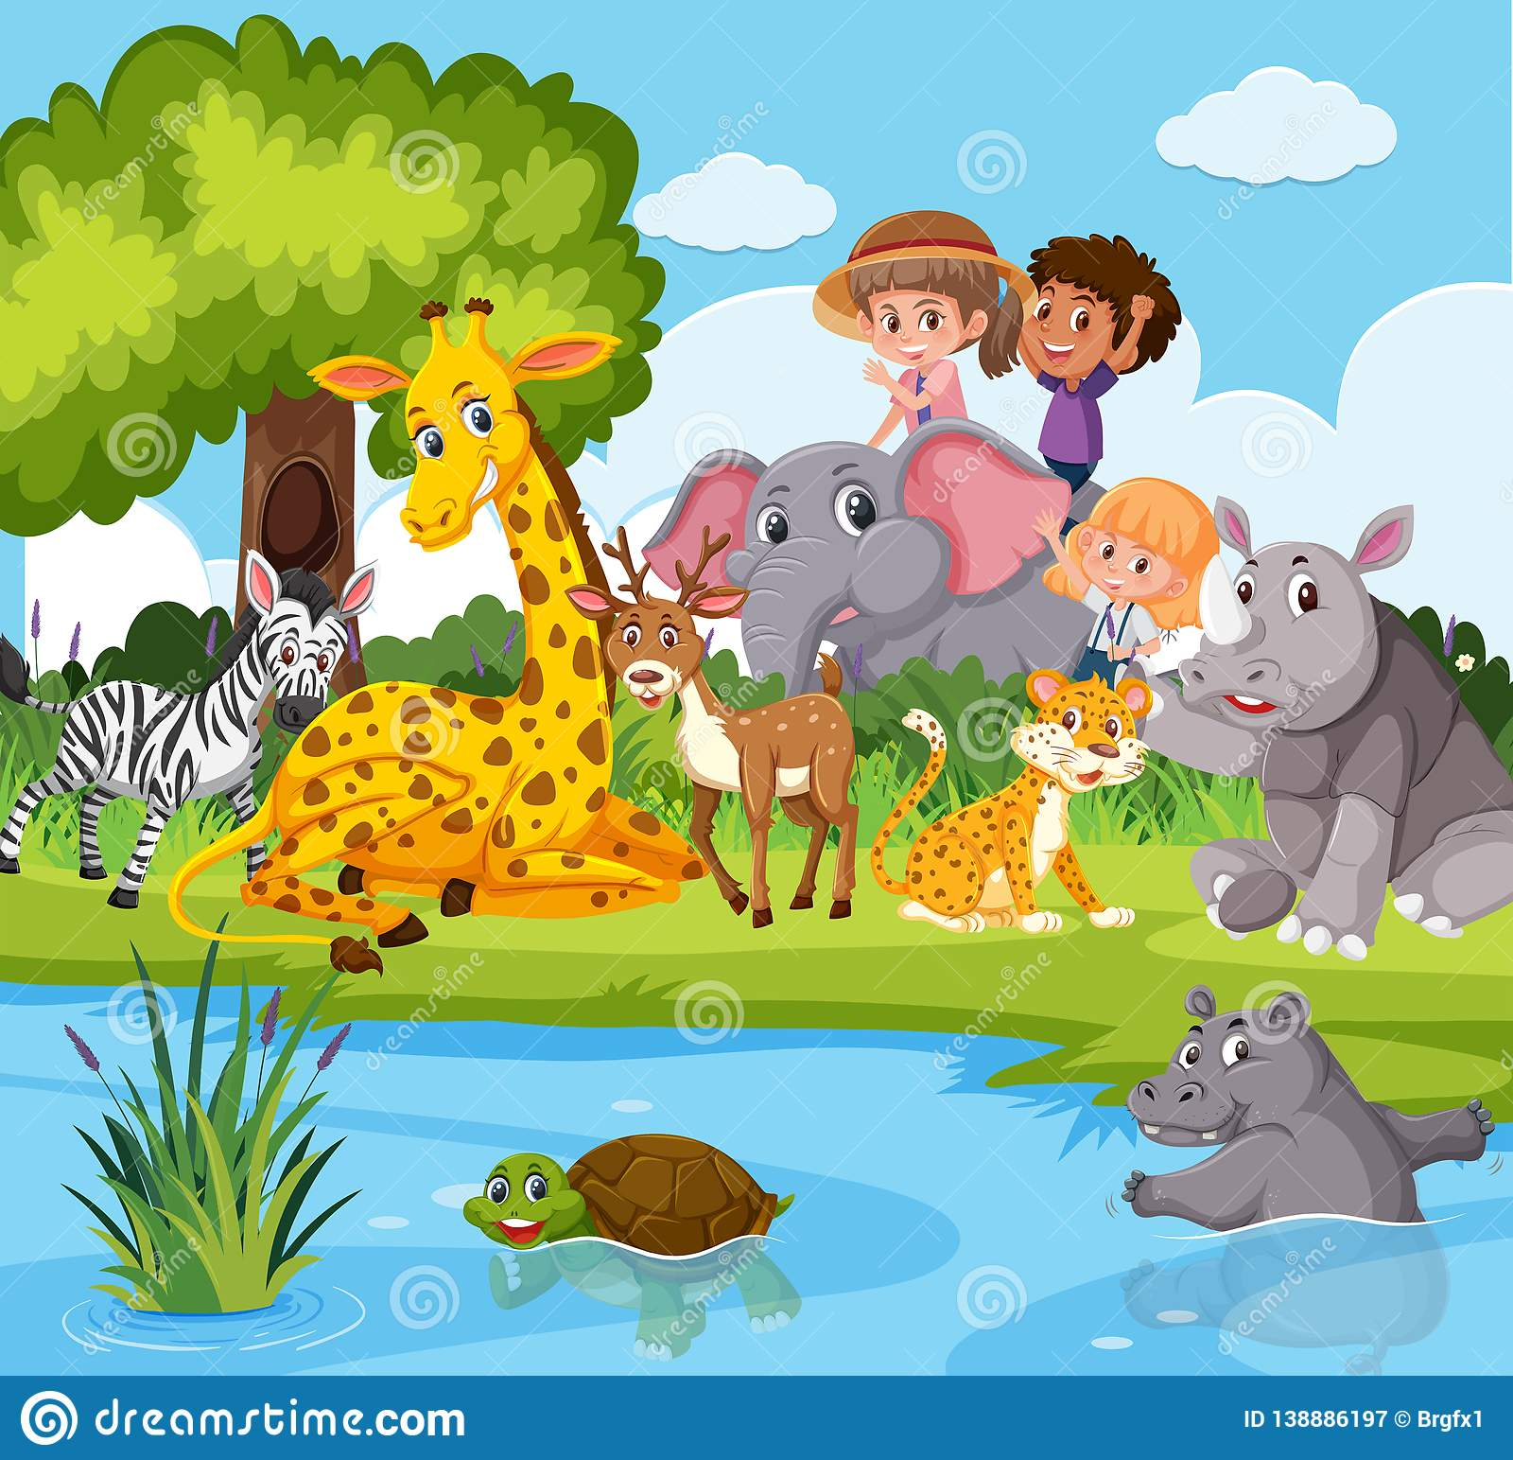
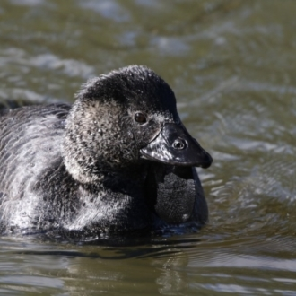
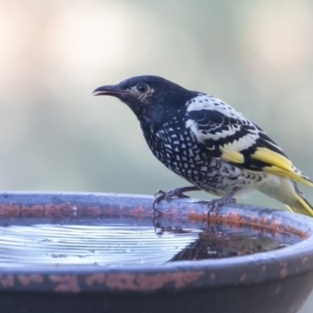
While some others are in danger .........
Biziura lobata
Anthochaera phrygia
And the fact is that many endangered animals may be living right next to us.

Slide 6
Our Goal: Is to let children and young people aware of animals and plants are our neighbors in nature and to inspire their curiosity to explore and learn about them.
Once they reach the three- to six-year age range, children have a strong desire to move and explore, and if they have opportunities to take
risks and succeed, they become more confident movers as they grow and mature.
Let's imagine .......
As Donnelly. et al (2007) point out, children have a strong desire to explore.

Slide 7
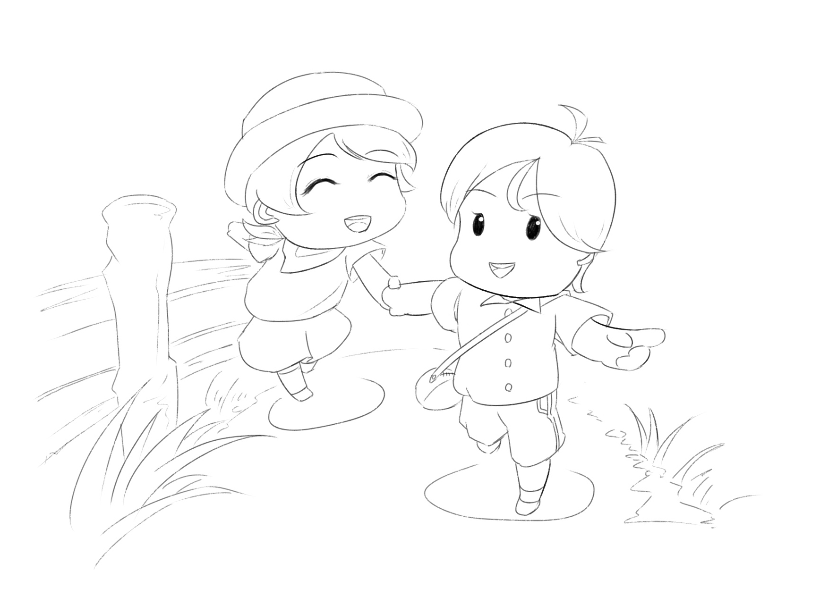
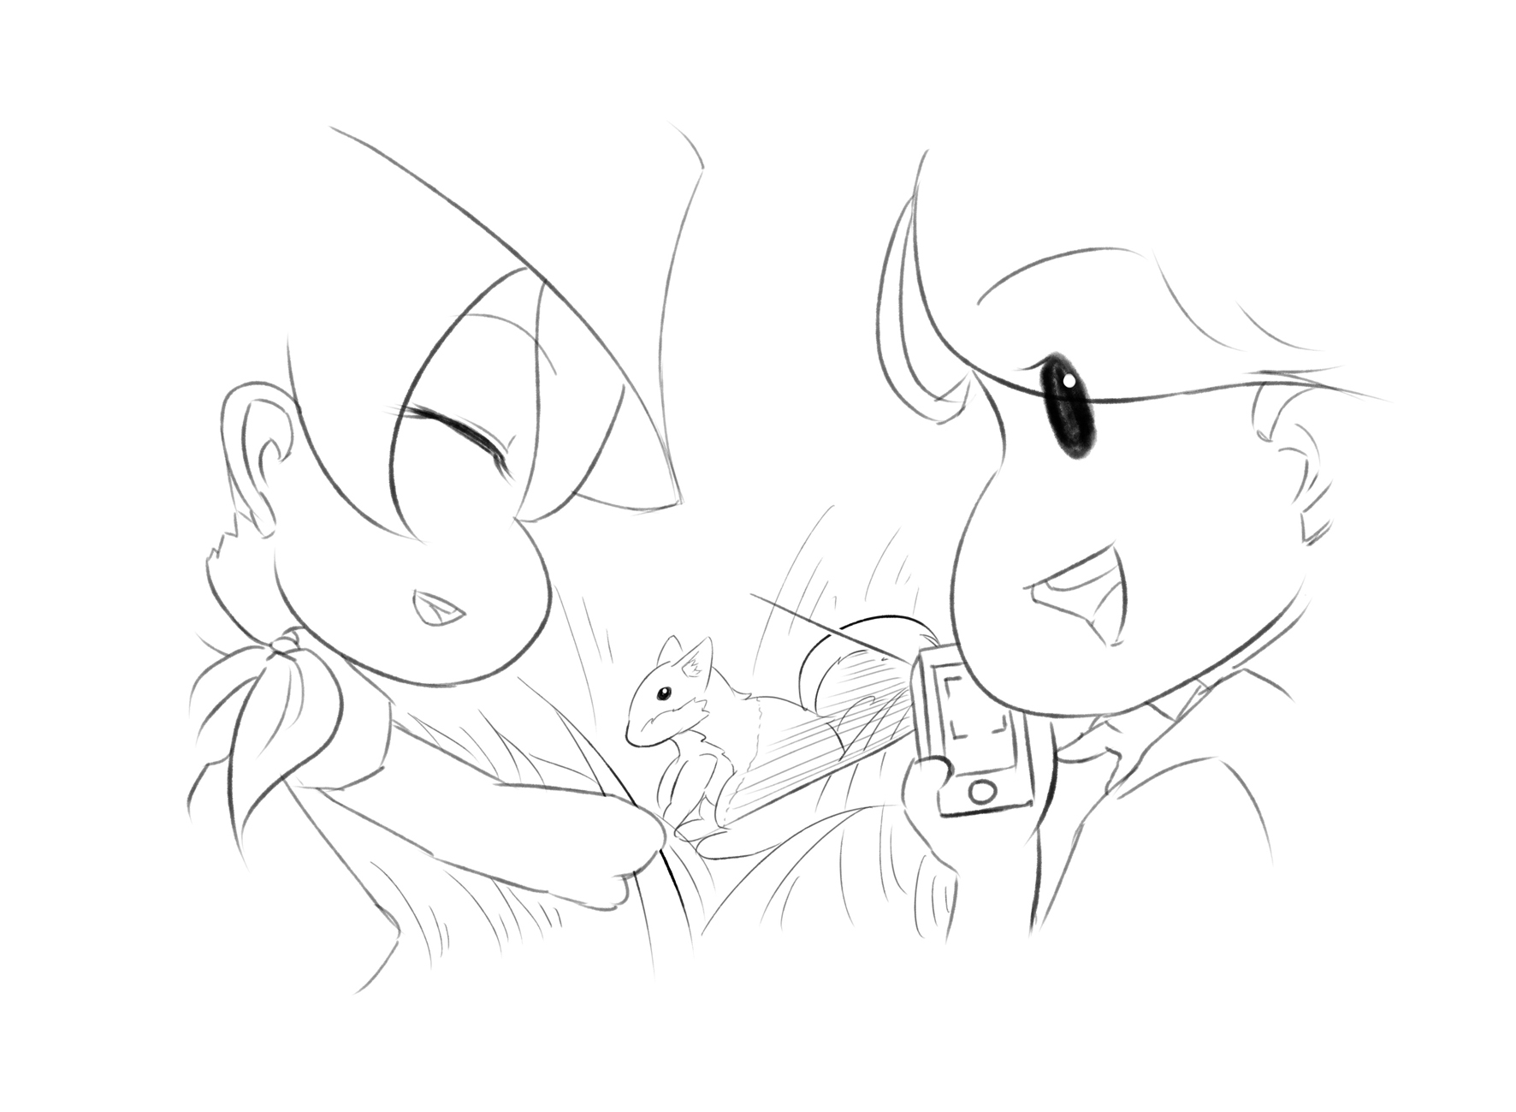
When children or teenagers go out to play...
An app allows them scan any plant or animal they find or they are interested in.
(Database and technology involved: Canberra Nature Map, Database of species in Queensland, Baidu Ai cloud Image Recognition )

Slide 8
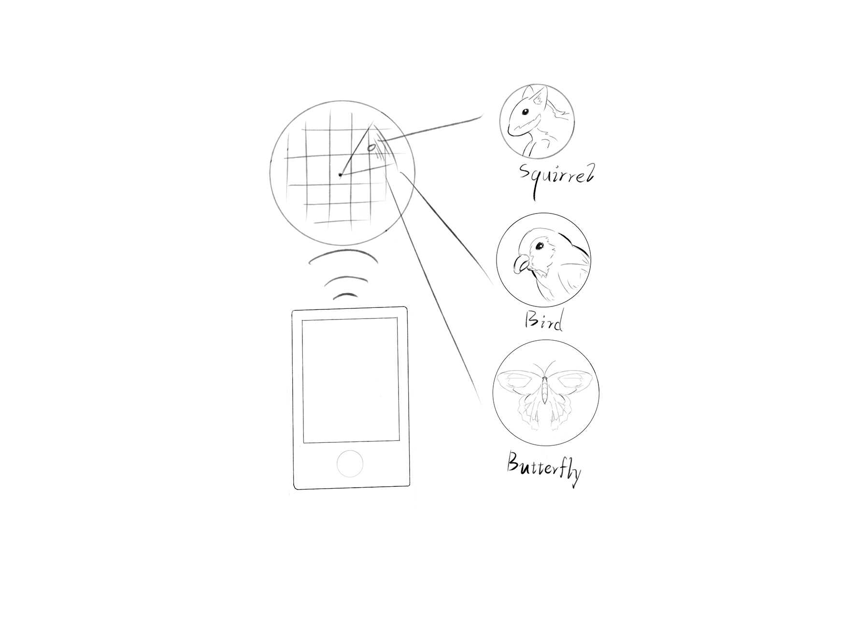
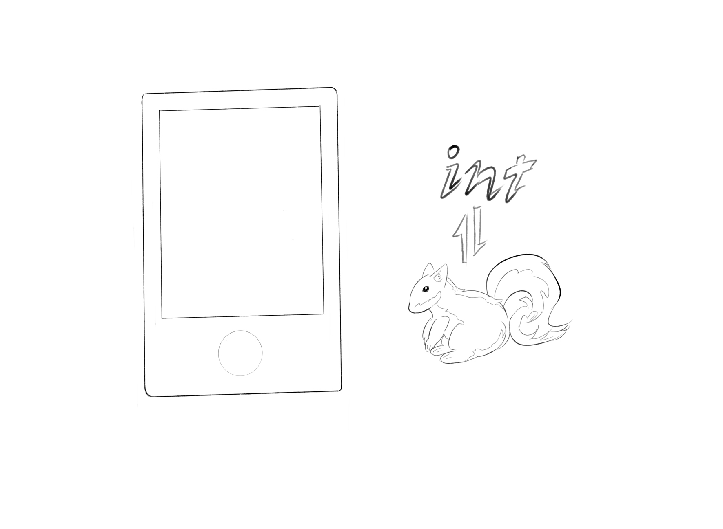
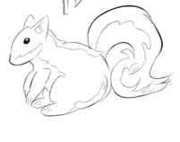
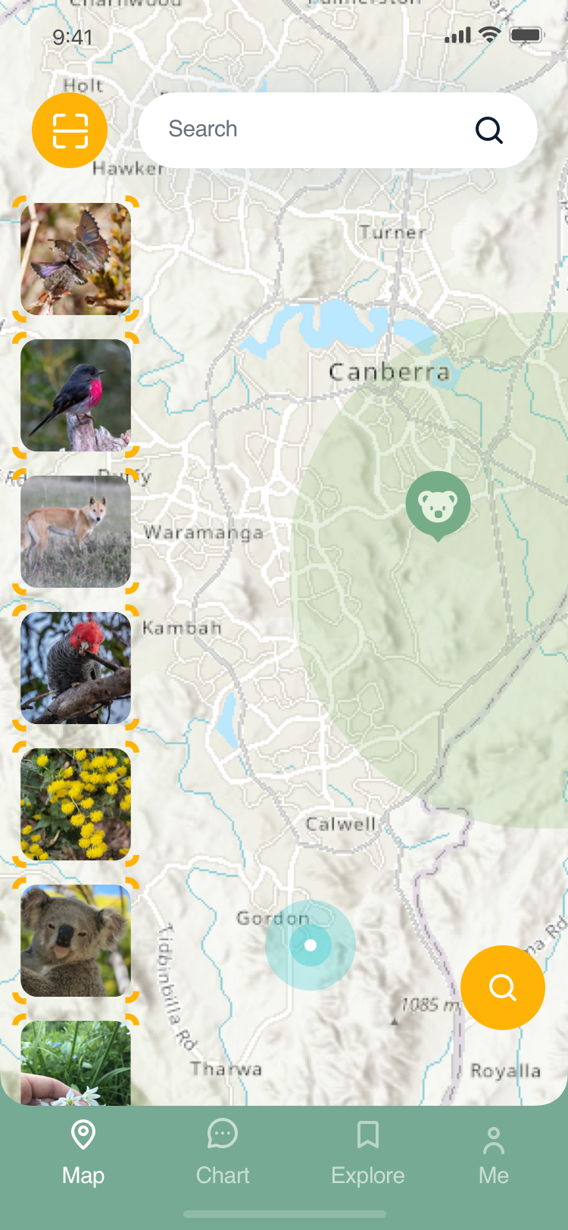
After scanning or choosing, the app will tell them the details of the animal or plants.
(The database involved : Canberra Nature Map ala.org.au,
Atlas living Australia)
Name: squirrel
living area:***
This app can also show children and teens what endangered plants and animals are near them, based on their location.
(The database involved : Canberra Nature Map ala.org.au, Database of species in
Queensland Risk to Biodiversity in the Wadeye Area, 2021)

Slide 9
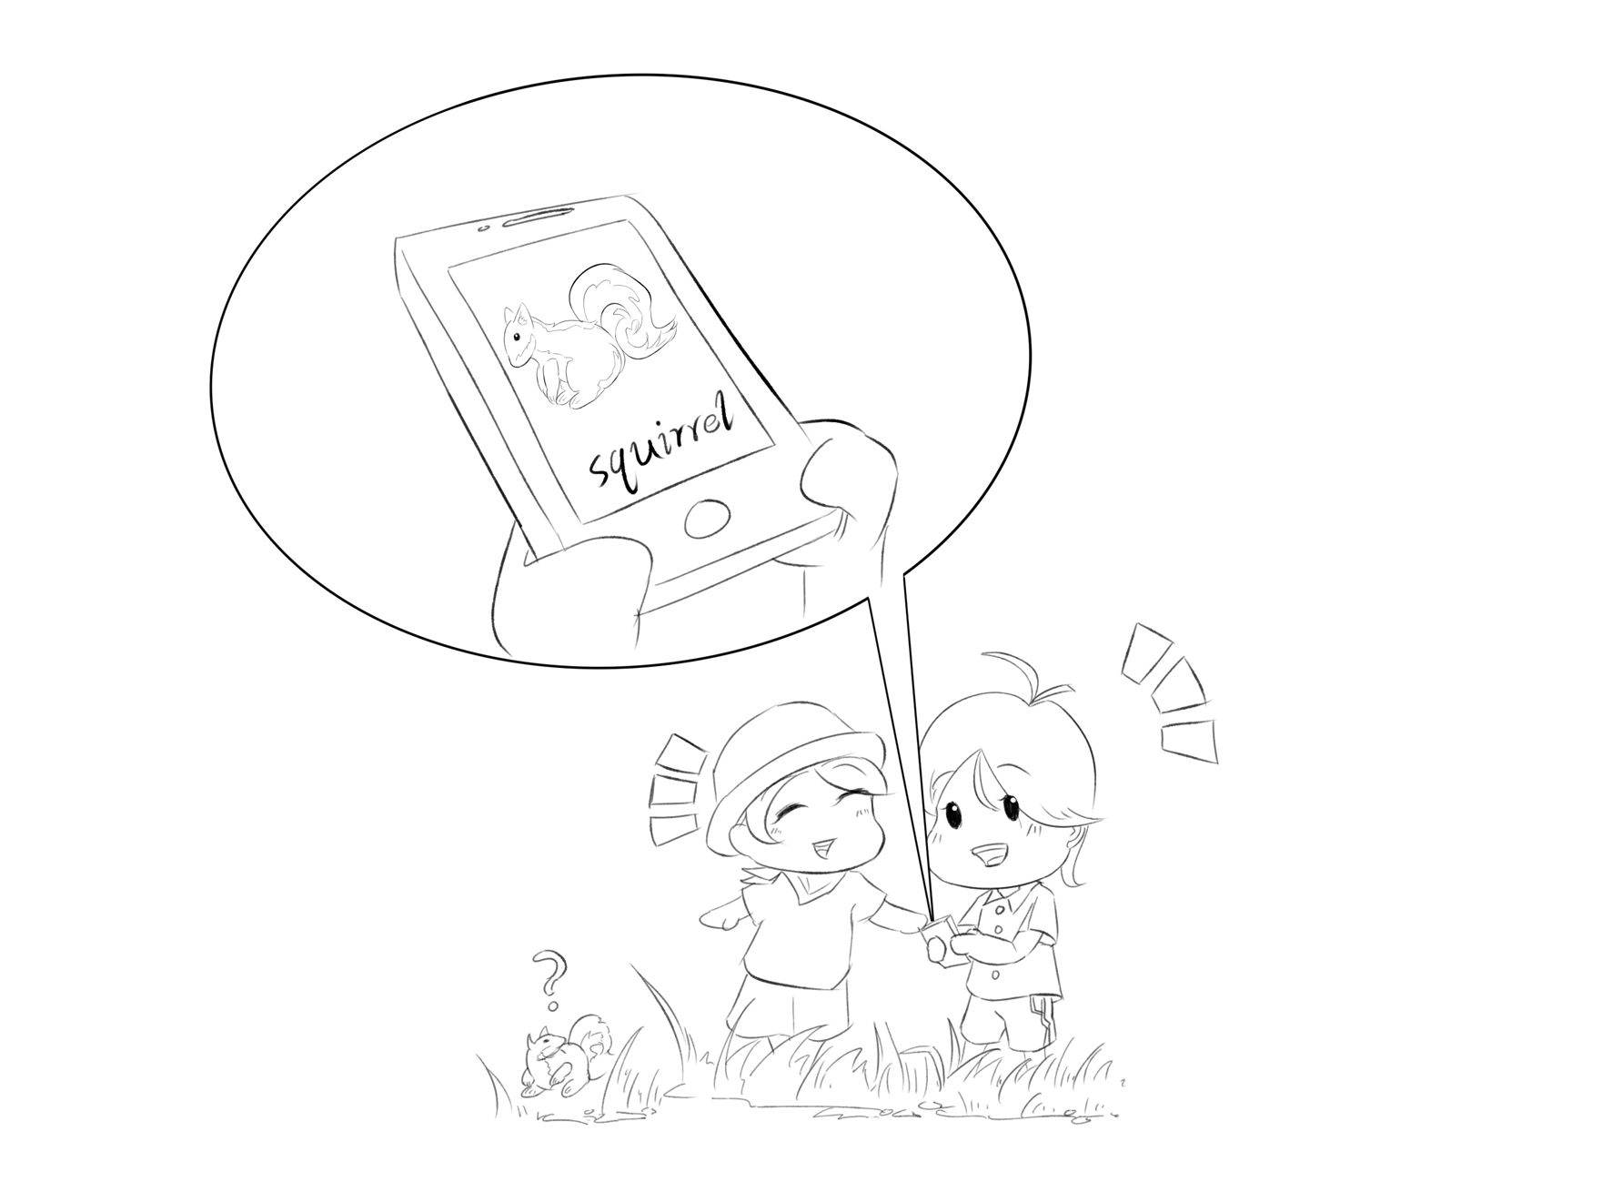
If the animal or plants is in the threatened animal database, a report interface will pop up for the user to report to the relevant departments
(The database involved : Canberra Nature Map ala.org.au, Threatened Fauna Habitat, and Risk to Biodiversity in the Wadeye Area, 2021)

